Slide 1


Data Visualization: Principles and Applications in R, Tableau, and Python
Silas Bergen
Todd Iverson
2019 Symposium on Statistics and Data Science
Bellevue, WA

Slide 2
SDSS data viz sessions to note
Thursday 10:30-12: Visual Storytelling
Alberto Cairo, U Miami
Matthew Brehmer, Microsoft
Amber Thomas, The Pudding
Thursday 1:30-3: Data viz in Python
Stephen Elson, Quantia Analytics
Dominik Moritz, U Washington
Kanit “Ham” Wongsuphawat, Apple
Friday 1:30-3: Data viz education
Michael Freeman, U Washington
Jerzy Wieczorek, Colby College
Robert Kosara, Tableau
Friday 3:40-5:15: Data viz at the IHME
Ryan Shackleton, IHME
Evan Laurie, IHME
Marlena Bannick, IHME
Friday 5:20-6:25: GoG 20th Anniversary
Lee Wilkinson, H2O.ai
Anushka Anand, Tableau
Jeffrey Heer, U Washington
Bryan Van de Ven, Microsoft
Saturday 10-11:30: GoG From Theory to Applications
Steven Drucker, Microsoft
Claus Wilke, U Texas Austin
Anushka Anand, Tableau
See entire data viz track: https://bit.ly/2QeAWFe

Slide 3
Today’s agenda
Viz theory and principles
Implementation in altair and ggplot2
Implementation in Tableau
Playtime

Slide 4
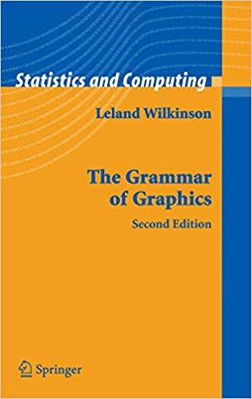
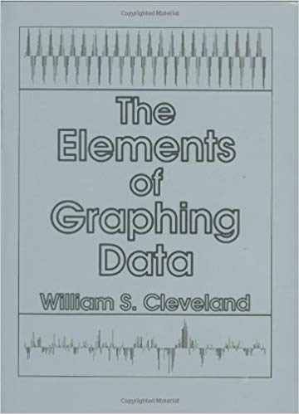

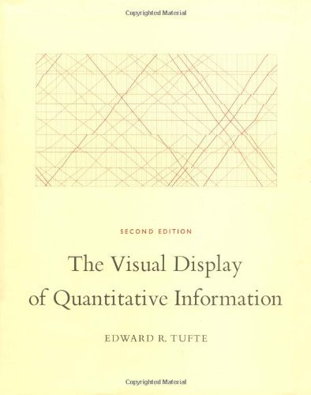
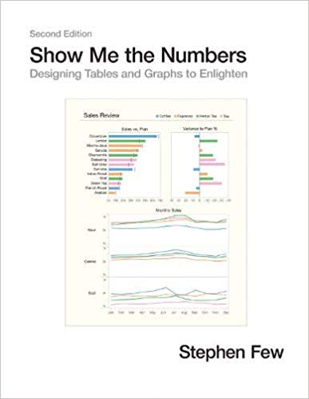
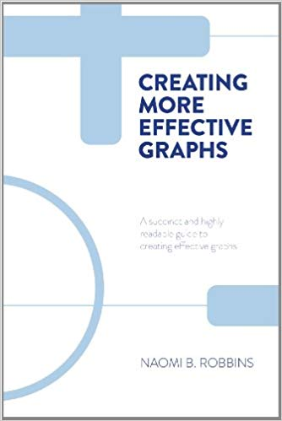


Slide 5
In the visualizations that follow:
What information can you extract?
How are you extracting this information?

Slide 6
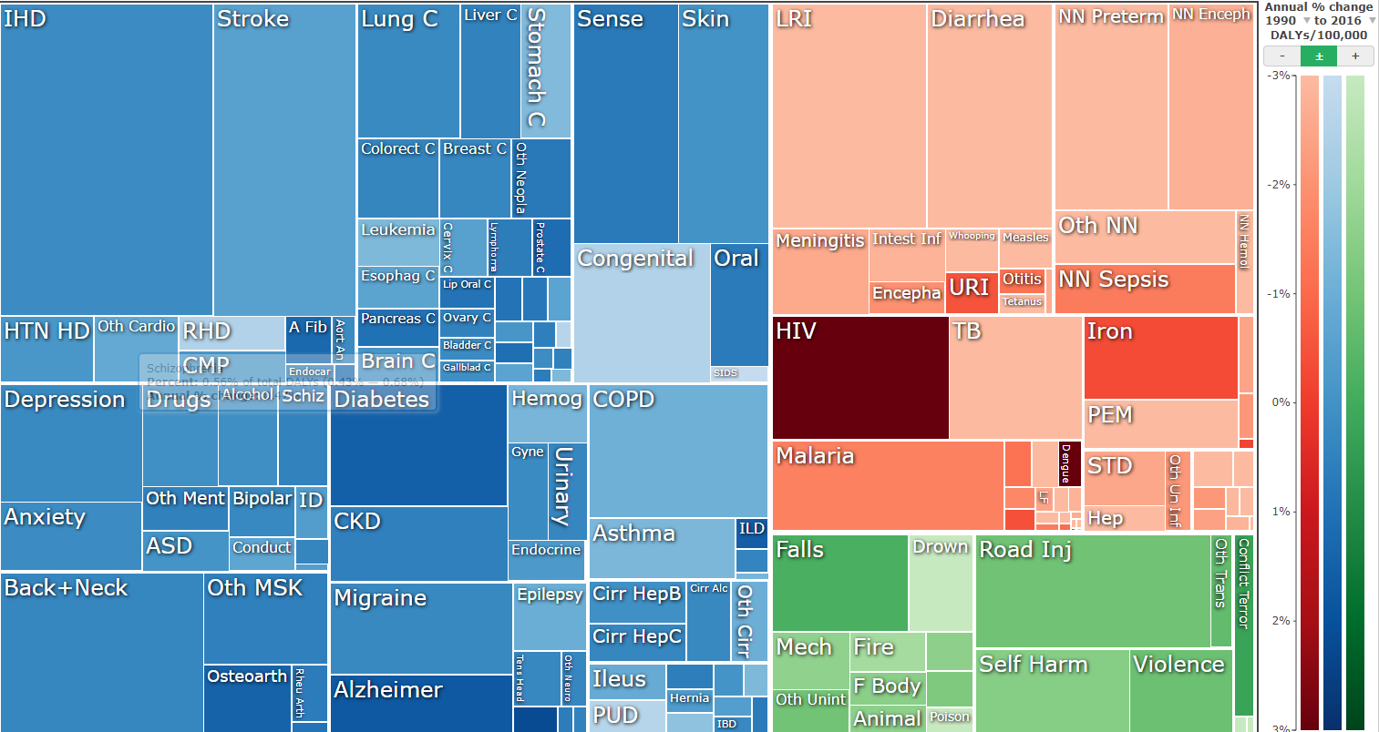
IHME disability adjusted life years (DALYs) visualization
https://vizhub.healthdata.org/gbd-compare/

Slide 7
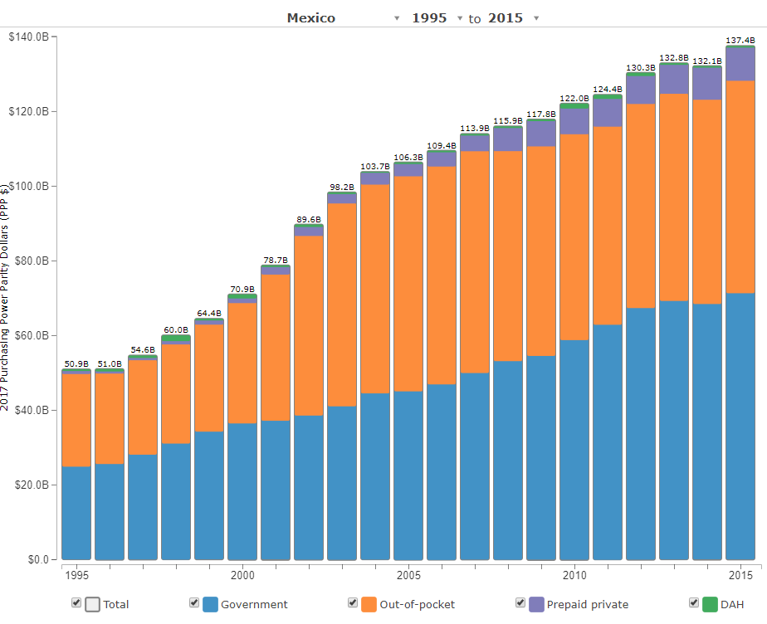
IHME health care spending visualization
(DAH = Development Assistance for Health)
http://ihmeuw.org/4iuu

Slide 8
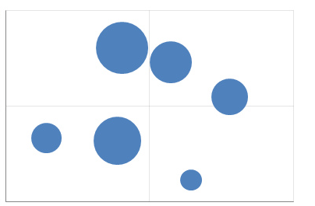
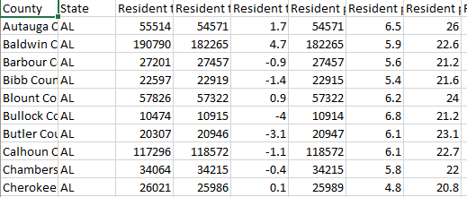
What is a data visualization?
A mapping of data to the visual aesthetics of geometries/marks
Many major visualization software (Tableau, ggplot in R, Altair in Python, graph builder in JMP) are based on this grammar
Aesthetic Map
Data
Geom/Mark

Slide 9
Geometry
A geometry or mark is a visual entity in space.
Some common geometries encountered in data visualizations:
Point
Line
Bar

Slide 10
Aesthetic
An aesthetic is a visual attribute of a geometry
Common aesthetics:
Position on horizontal (X)
Position on vertical (Y)
Shape
Size
Color
Hue
Saturation (“intensity”)
Value (“brightness”)
Text
Not all aesthetics are available for every geometry

Slide 11

HUE
SATURATION
https://color.adobe.com/build2.0.0-buildNo/resource/img/kuler/color_wheel_730.png

Slide 12
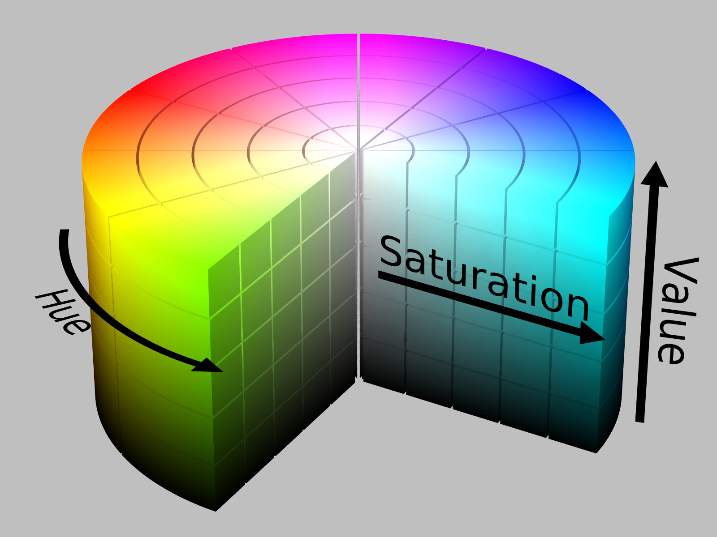
https://upload.wikimedia.org/wikipedia/commons/0/0d/HSV_color_solid_cylinder_alpha_lowgamma.png

Slide 13
Aesthetic attributes of a point geometry
What distinguishes one point from another point?
X, Y
Shape
Size
Hue
Saturation
Value
Text
Point B
Point A

Slide 14
Aesthetic attributes of a line geometry
What distinguishes one line from another line?
X, Y
Shape
Size
Hue
Saturation
Value

Slide 15
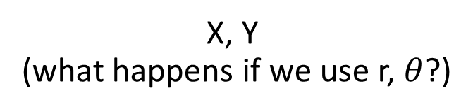
Aesthetic attributes of a bar geometry
What distinguishes one bar from another bar?
X, Y
(what happens if we use r, $θ$?)
Shape
Size
NA
(a bar is a bar!)
Hue
Saturation
Value

Slide 16
Data
To visualize, must have data in row-by-column format where:
Rows represent cases: at most one geometry per case (assuming no aggregation)
Columns represent variables: to be mapped to aesthetic attributes

Slide 17
Specifying a data visualization
Differences in geometry aesthetics map to differences in data variables
Available mappings depend on whether data variable is continuous (height) or discrete (race)

Slide 18


Specifying a data visualization
The following caveats apply:
An aesthetic attribute can be mapped back to at most one variable
A variable can be mapped to more than one aesthetic
Not all mappings make sense
Height
Size
Age
Size
Sex
Hue
Height
Shape

Slide 19
Modifiers
Ties: when two cases yield overlapping geometries under a given mapping
Some common modifiers:
Jitter: Stack: Dodge:
+
=

Slide 20
Specify the mappings!
Revisit the three visualizations we encountered earlier. Identify:
The data cases (assuming one geometry per case);
The geometries;
The aesthetic attributes that are varied;
The variables that control the differences in aesthetic attributes (bonus: are they continuous or discrete?)
Modifiers (if any)

Slide 21
IHME GBD visualization
Data row:
one disease
Geometry:
rectangle
Variables/mapping:
% DALYs due to (area)
Category (hue)
% Change (saturation)
https://vizhub.healthdata.org/gbd-compare/
Notes:
Quickly; add “key” slides

Slide 22
IHME health care spending visualization
Data row:
one spending source-year tuple
Geometry:
bar
Variables/mapping:
Year (X)
Spending (Y)
Source (Hue)
Modifier: Stack
http://ihmeuw.org/4iuu
Notes:
Quickly; add “key” slides

Slide 23
Visual perception
How we compare quantities

Slide 24
Recall the following aesthetic attributes:
Position on horizontal (X)
Position on vertical (Y)
Shape
Size
Color
Hue
Saturation (“intensity”)
Value (“brightness”)
Cleveland & McGill created a ranking of these when mapping a geometry to a quantitative variable

Slide 25
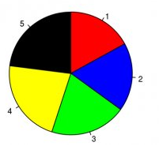
Hypothetical polling data on 5 candidates.
Rank the candidates’ vote shares.
Walter Hickey at Business Insider
Specification
Geometry: “pie wedge” (a bar in polar coordinates)
Aesthetic mappings:
Candidate (discrete) → hue & text
share of vote (continuous) → size, specifically angle

Slide 26
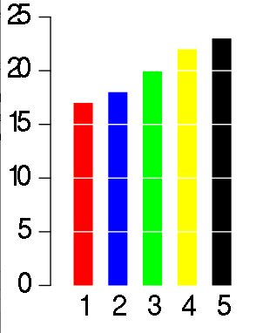
Same data, different visualization
Rank the candidates’ vote shares.
Walter Hickey at Business Insider
Specification
Geometry: bar
Aesthetic mappings:
candidate → hue & X
share of vote → Y

Slide 27
Elementary perceptual tasks
a set of tasks that are carried out when people extract quantitative information from graphs
Cleveland and McGill. Graphical Perception: Theory, Experimentation, and Application to the Development of Graphical Methods. JASA, 1984

Slide 28
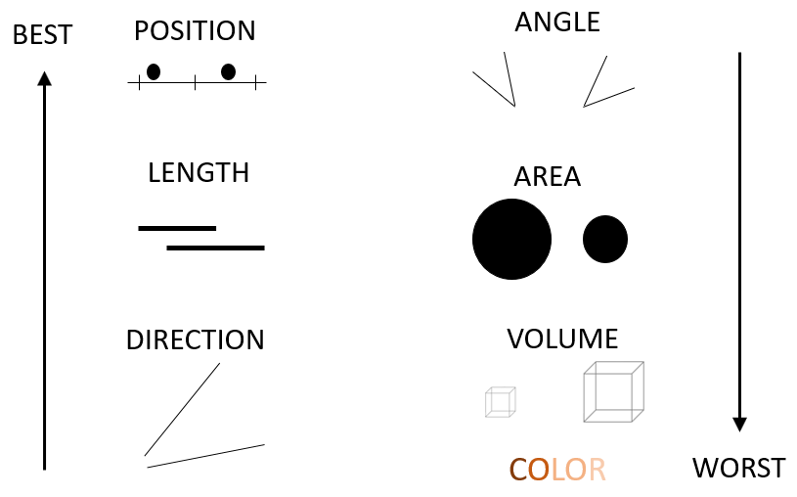
Cleveland’s and McGill’s hierarchy of elementary perceptual tasks

Slide 29
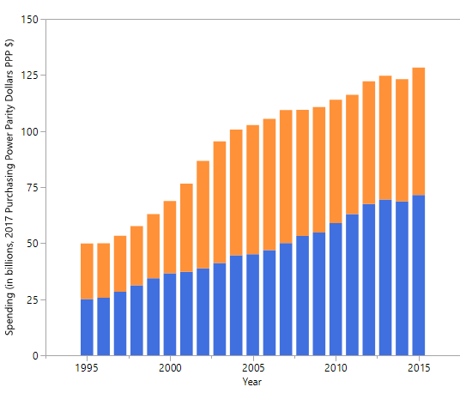
Mexico’s health spending (Government and Out-of-pocket only)
Geometry: Bar
Year → X
Spending → Y
Source → Hue
Modifier: Stack
Geometry: Bar
Year → X
Spending → Y
Source → Hue
Modifier: Dodge
Geometry: Point
Year → X
Spending → Y
Source → Hue, Shape
Modifier: None

Slide 30
Gestalt principles
How we perceive groups

Slide 31
gestalt = form or pattern
Gestalt philosophy: the whole is greater than the sum of the parts
Gestalt principles: predictable ways by which we organize sensory information
Developed by Max Wertheimer & followers; early 20th century

Slide 32
Find the fives
6
3
1
2
1
9
5
3
2
8
5
5
7
5
5
4
9
5
5
4
3
6
5
3
9
4
3
5
8
2
2
1
5
7
4
3
1
5
5
7
6
5
9
8
4
2
4

Slide 33
Find the fives
6
3
1
2
1
9
5
3
2
8
5
5
7
5
5
4
9
5
5
4
3
6
5
3
9
4
3
5
8
2
2
1
5
7
4
3
1
5
5
7
6
5
9
8
4
2
4
Inspired by Fig 6.2, The Functional Art by Alberto Cairo

Slide 34
Similarity
rows or columns?

Slide 35
Similarity
rows or columns?

Slide 36
Proximity
rows or columns?

Slide 37
Connection
rows or columns?

Slide 38
Enclosure
rows or columns?

Slide 39
Some principles are stronger than others

Slide 40
rows or columns?

Slide 41
rows or columns?

Slide 42
What are the groups?
Within group: rows or columns?
Notes:
Left/right
Within left: columns; within right: rows

Slide 43
Implications for practice
Know how we compare quantities
Know how we perceive groups
Employ these principles to facilitate the most important comparisons
“The most important comparisons” depend on your message

Slide 44
> fake_data
Factor1 Factor2 Response
1 A I 15
2 A II 5
3 A III 5
4 B I 10
5 B II 15
6 B III 15
7 C I 5
8 C II 10
9 C III 10

Slide 45
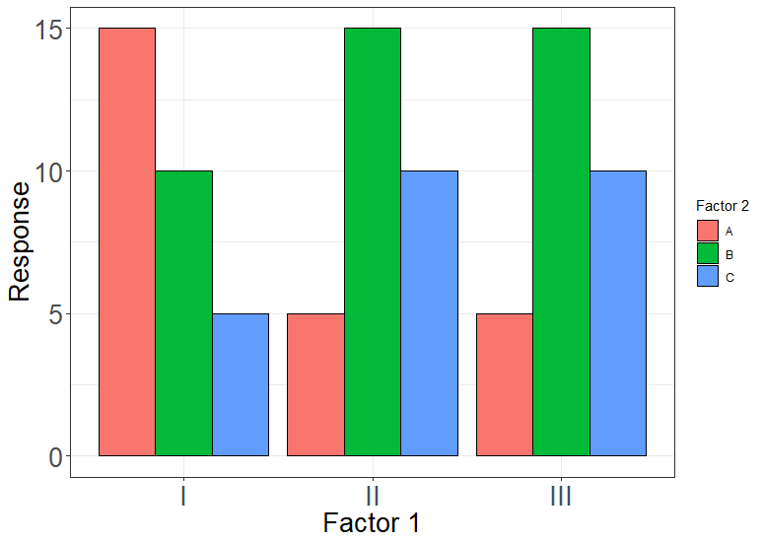
Geom: bar
Position_X: Factor 1
Color: Factor 2
Position_Y: Response
Notes:
775 x 550; proximity

Slide 46
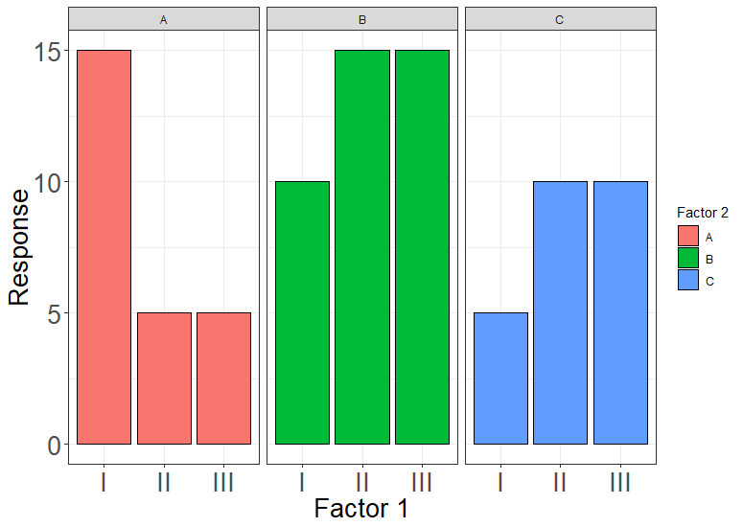
Geom: bar
Position_X: Factor 1
Color: Factor 2
Position_Y: Response
FACET: Factor 2
Notes:
775 x 550; proximity + enclosure

Slide 47
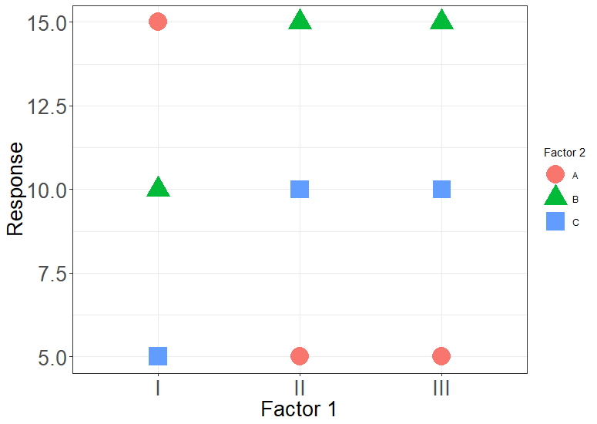
Geom: point
Position_X: Factor 1
Color: Factor 2
Shape: Factor 2
Position_Y: Response
Notes:
What am I supposed to look at? Similarity is too weak

Slide 48
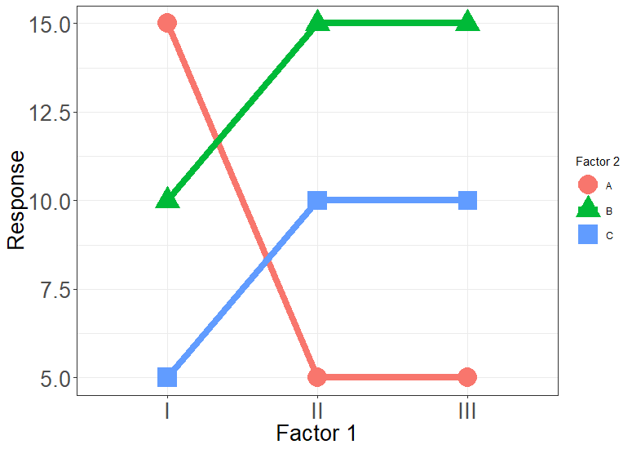
Geom: point
Position_X: Factor 1
Color: Factor 2
Shape: Factor 2
Position_Y: Response
Geom: line
Position_X: Factor 1
Color: Factor 2
Group: Factor 2
Position_Y: Response
Notes:
Adding connection helps

Slide 49
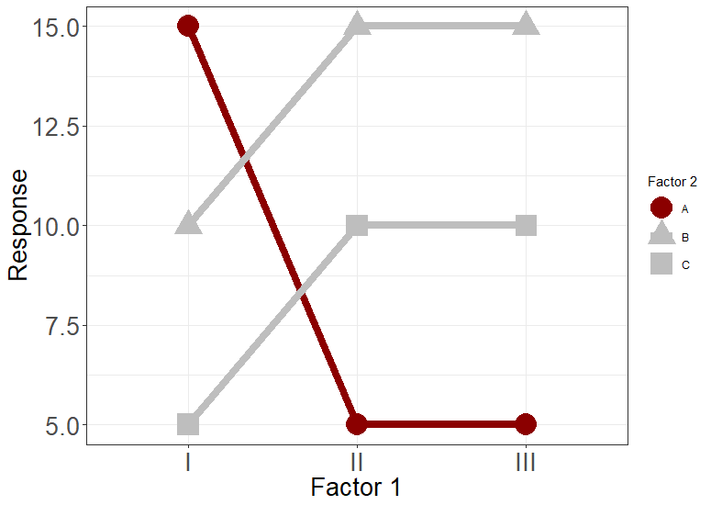
Geom: point
Position_X: Factor 1
Color: Is_neg
Shape: Factor 2
Position_Y: Response
Geom: line
Position_X: Factor 1
Color: Is_neg
Group: Factor 2
Position_Y: Response
Notes:
Similarity + connection

Slide 50
Geom: point
Position_X: Factor 1
Color: Is_neg
Shape: Factor 2
Position_Y: Response
Geom: line
Position_X: Factor 1
Color: Is_neg
Group: Factor 2
Position_Y: Response
Notes:
Enclosure + Similarity + connection

Slide 51
Goals of data visualization

Slide 52


Explanatory
Designer has primary message to convey
Visualization designed to convey this message
?

Slide 53
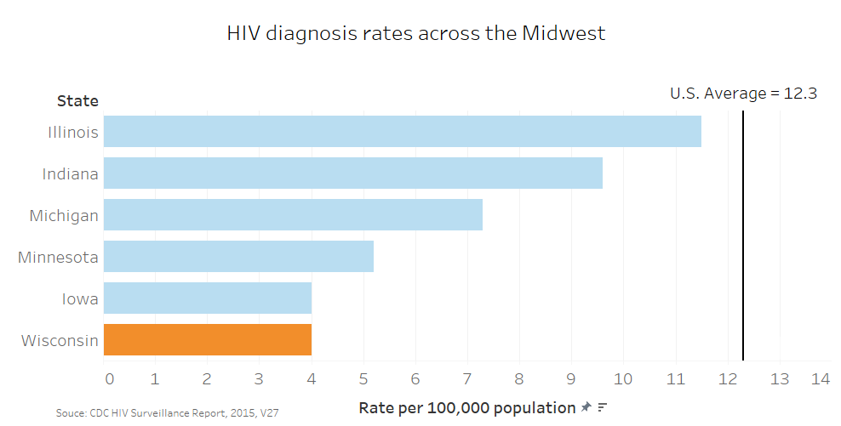

Slide 54
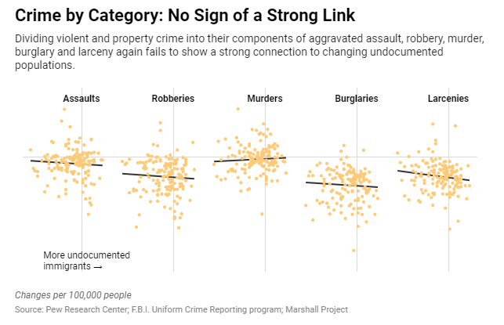
https://www.nytimes.com/2019/05/13/upshot/illegal-immigration-crime-rates-research.html

Slide 55
Exploratory
Designer facilitates exploration
Viewer familiarizes herself with visualization, asks questions, gains insight
Often involves interactivity
?

Slide 56
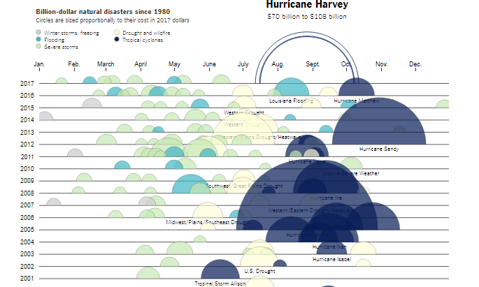
https://www.nytimes.com/interactive/2017/09/01/upshot/cost-of-hurricane-harvey-only-one-storm-comes-close.html

Slide 57
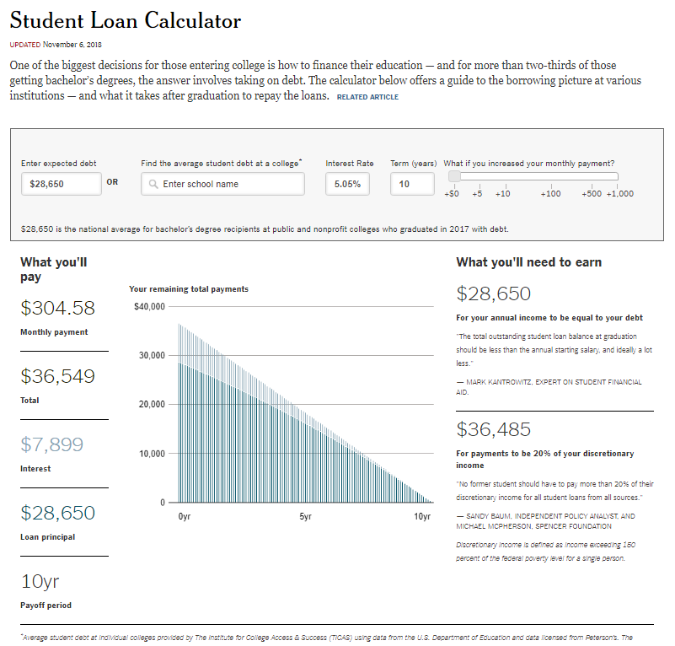
https://www.nytimes.com/interactive/2017/your-money/student-loan-repayment-calculator.html

Slide 58

What do you do when you have a lot of data? What if you don’t have a lot of time to poke at a dataset? How should you visualize your data? Here’s what you can do.
Ask the data questions.
Start with the visualization basics.
Focus.
Nathan Yau
https://flowingdata.com/2017/01/24/one-dataset-visualized-25-ways/

Slide 59
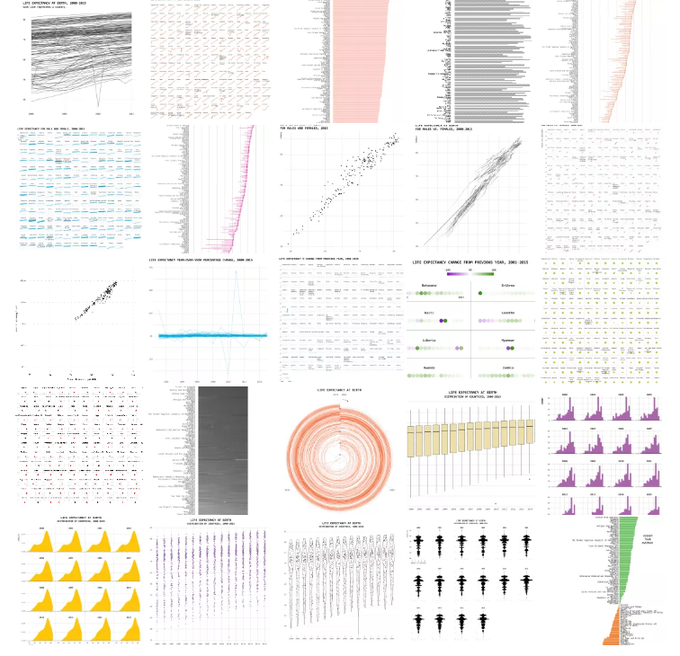
As you learn more, you get more choices, which in itself can be a challenge. Resist the temptation to add so many things to your visualization that it obscures the original purpose.
That said, don’t use this as an excuse to resist trying new things. You won’t know how far you should go until you’ve gone too far.
Iterate.
Practice.
Then let the data speak.
-Nathan Yau
https://flowingdata.com/2017/01/24/one-dataset-visualized-25-ways/

